Slide 1

Take Home Test II
Anthony Ramos
CSC342/43 – Spring 2021

Slide 2

Objective
Analyze Stack Frames using recursion across three different architecture sets.

Slide 3
GCD Recursive

Slide 4
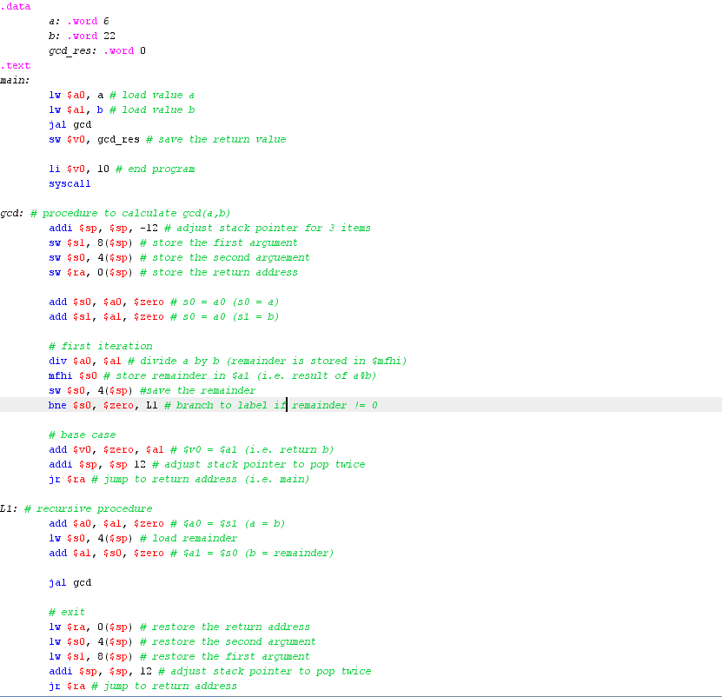
MIPS Assembly on MARS Simulator
Figure 1: gcd.asm

Slide 5
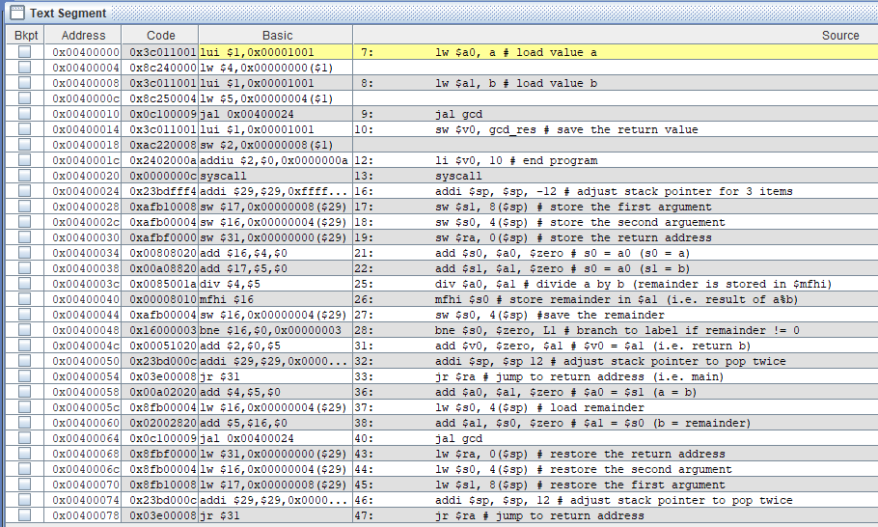
MIPS Assembly on MARS Simulator
Figure 2: Text Segment showing all instructions

Slide 6
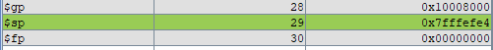
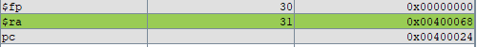
MIPS Assembly on MARS Simulator
Stack Pointer
Argument values
Return Address
Memory locations
Figure 3: An instance of a stack frame

Slide 7
MIPS Assembly on MARS Simulator
Return address of gcd()
Address: 0x7FFFEFE4
Return address of gcd()
Address: 0x7FFFEFCC
Argument 1 at level gcd(4,2)
Address: 0x7FFFEFD4
Remainder at level gcd(6,4)
Address: 0x7FFFEFDC
Remainder at level gcd(4,2)
Address: 0x7FFFEFD0
Value: 0
Return Address of gcd()
Address: 0x7FFFEFD8
Argument 1 at level gcd(22,6)
Address: 0x7FFFEFEC
Value: 22
Remainder at level gcd(6,22)
Address: 0x7FFFEFF4
Argument 1 at level gcd(6,4)
Address: 0x7FFFEFE0
Value: 6
Remainder at level gcd(22,6)
Address: 0x7FFFEFE8
Value: 4
Return address of main()
Address: 0x7FFFEFF0
Figure 4: All argument and return address values

Slide 8
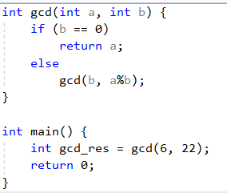
Intel X86 MS Visual Studio
Figure 5: gcd.c

Slide 9
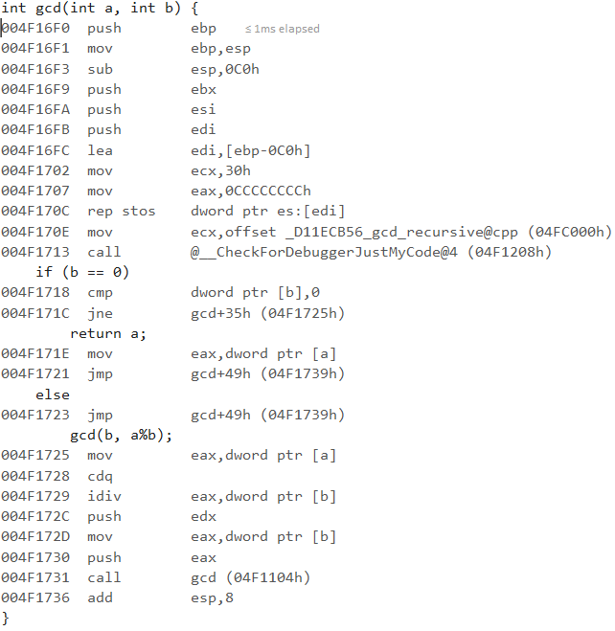
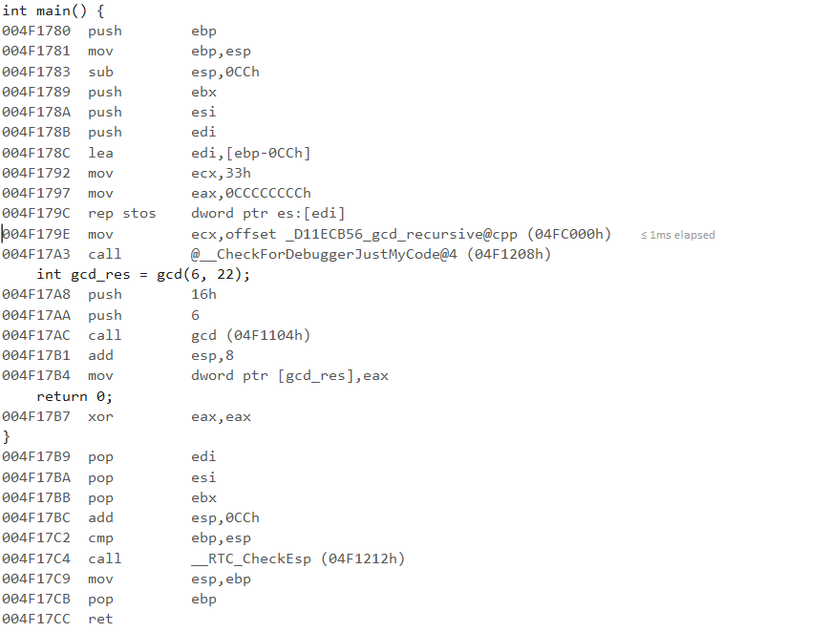
Intel X86 MS Visual Studio
Figure: 6 Assembly code for main() and gcd()

Slide 10
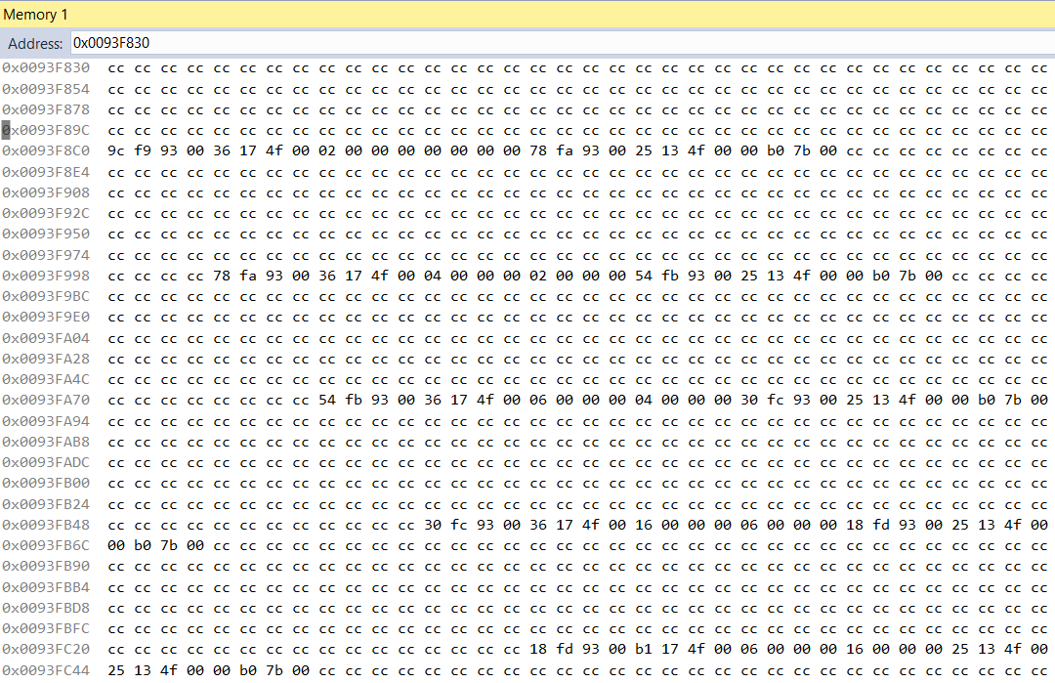
Intel X86 MS Visual Studio
gcd(2,0)
gcd(4,2)
Base Pointer
Return Address
gcd(6,4)
Argument 1
Argument 2
gcd(22,6)
gcd(6,22)
Figure 8: Stack frames of entire program

Slide 11
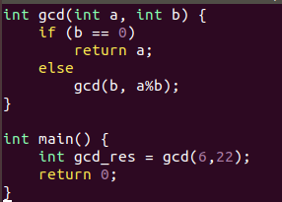
IntelX86 64-Bit (Linux GDB)
Figure 9: gcd.c

Slide 12
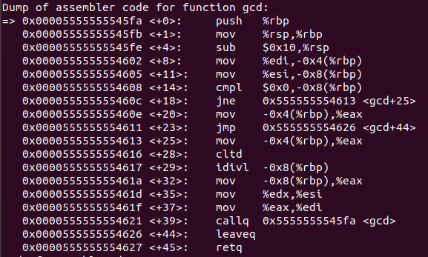
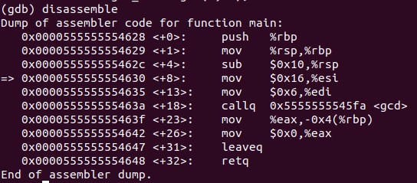
IntelX86 64-Bit (Linux GDB)
gcd()
main()
Figure 10: Disassembly of gcd.cpp

Slide 13
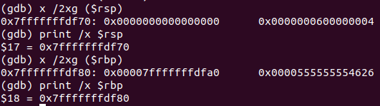
IntelX86 64-Bit (Linux GDB)
Argument 2 value at current level
new stack pointer
Argument 1 value at current level
Old base pointer
Return addresses
new base pointer
Figure 11: An instance of a Stack Frame

Slide 14
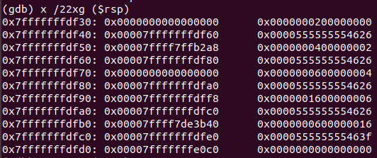
IntelX86 64-Bit (Linux GDB)
Stack Pointer Argument 1
Base Pointer Argument 2
Return Address
gcd(2,0)
gcd(4,2)
gcd(6,4)
gcd(22,6)
gcd(6,22)
Figure 12: Stack frames of entire program

